Slide 1
GEO and EMCOM
Local Hams to provide valuable assistance to our city, state, and nation

Slide 2
Amateur Radio
A communications service as allowed by the Federal Law The Communications Act of 1937
Governed by Part 97 of the Federal Communications Commission regulations under the authority granted by the Communcations act, as amended
Provides for experimentation by those who do it for the love of it in the radio art and not for pay (Amateur, Latin)
But it also encourages use of our valuable frequencies to provide emergency communications and it is an obligation

Slide 3
Emergency Communications
“When normal communications systems are not available, amateur stations may make transmissions necessary to provide essential communication needs in connection with the immediate safety of human life and immediate protection of property” [47 CFR 97.403]. “This provision of emergency communications is regulated by Part 97, Subpart E of the FCC's rules. One advantage for amateur radio operators in public emergency communications is the wide range of available frequencies” [47CFR 97.407]
But as mentioned, it is “For the love of it and not for pay” the Latin derived word Amateur means exactly that and FCC rules prevent doing it for pay by regulation

Slide 4
GEO I
Dr. Robert McGwier, formerly of NSA was an amateur radio volunteer at ground zero following 9/11.
Now Director of Research for the Hume Center for National Security and Technology at Virginia Tech
Serving the Red Cross starting on 9/12 using amateur radio, we were THE ONLY COMMUNICATIONS AVAILABLE to do logistics for first responders for days

Slide 5
GEO II
Dr. McGwier’s brother lived in Slidell, LA during Hurricane Katrina
ALL communications necessary for coordination of logistics and rescue were nearly destroyed.
Amateur radio, arriving on the scene in New Orleans were completely uncoordinated and time was wasted getting them integrated with search and rescue and more

Slide 6
GEO III
Recently multiple firefighters in the state of Washington died fighting wild fires because they could not communicate in time to say they were in trouble and needed to be extracted
Amateur radio operators could provide operational relays easily IF they were given a service to bring to the party

Slide 7
GEO IV
Michelle Thompson and Dr. McGwier jointly have worked on providing a ground station relay and a geo satellite platform respectively since 2007
Dr. McGwier discovered that Millennium Space Systems of El Segundo, CA was preparing a spacecraft for the USAF.
It is called Wide Field of View
It has excess power and space for our antennas and can carry our communications facility (repeater)
This GEO provides a communications relay for the entire United States except for Hawaii and Western Alaska
24 hours a day, 7 days a week, 365 days a year just like DirecTV

Slide 8
GEO V
Dr. McGwier and Dr. Kay Craigie, President of the American Radio Relay League meet with the adminstrator of FEMA on September 14 this year
ARRL represents all amateurs in the US and has a MOU with FEMA to utilize amateur radio to aid FEMA in big disasters
FEMA and ARRL work with local EOC (Cal OES included) to aid their operations but lack a coordinated and inexpensive facility to provide communications

Slide 9
Test site for GEO
The City of Escondido, CA is uniquely positioned to provide a major test site for development and testing of this facility
Dixon Lake, to the East, sees Palomar Ridge where the Palomar Amateur Radio Club owns an antenna site and can support equipment that acts like the satellite
Dixon Lake , to the West, sees the city of Escondido where the first responders can provide test
At first it will be amateur radio operator handhelds but it can eventually include P25 radios used by Dixon Lake Supervisors and Rangers to emulate first responders and get relayed through the “spacecraft” to Cal OES.

Slide 10
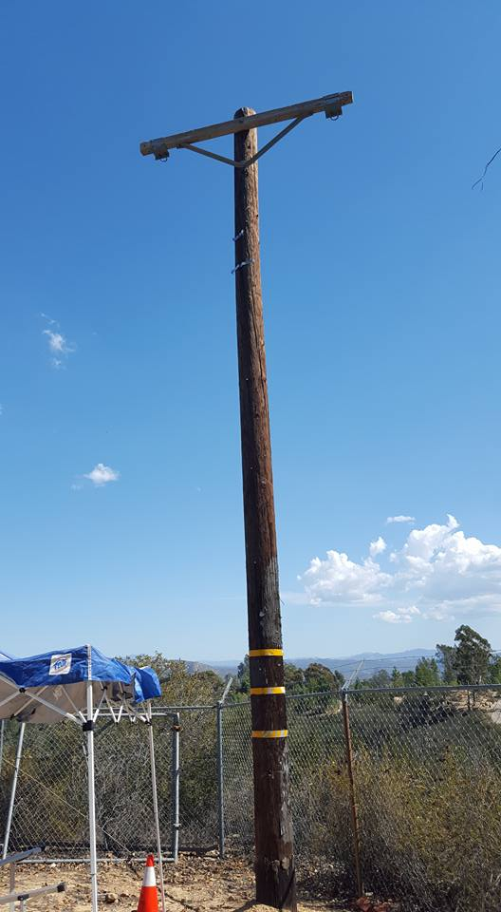
Dixon Lake
We request access to this unused telephone pole inside the security fence at the Escondido Water Tank

Slide 11
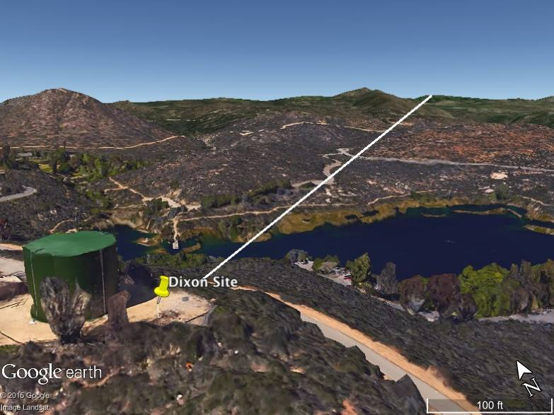
Dixon Lake to Palomar
Dixon Lake and Palomar are line of sight.

Slide 12
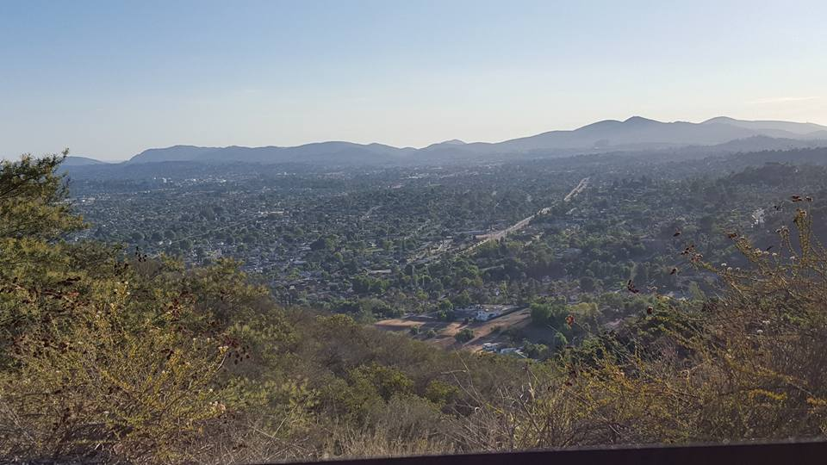
City of Escondido
As seen from Water Tower

Slide 13
We request
An 8 foot tall, 2 inch pipe installed by four bolts on the unused telephone pole
Antennas mounted on the pipe needed for our tests
A small capacity storage unit supplied us for our equipment (initially a rubber maid tub). It will contain electronics/battery at the base of the telephone pole
Solar panels not attached to anything except our stand, ground mounted to charge a battery to operate the equipment
After test of our equipment and proof of solar system working, we request that Escondido allow us to run a single extension cord from the power connector on the water tower through a professional electrical box, fused and environmentally safed and mounted on the pole to run our longer term development and tests and both day and night support of emergency response exercises. We will pay for the electrical service and the electricity consumed if necessary. We are expecting it to be the same amount of power consumed by three light bulbs and can easily measure this.

Slide 14
We agree
To operate the equipment when the City of Escondido allows and in accordance to FCC regulations, Part 97 governing the amateur service
To operate the equipment on a completely noninterference basis with ALL communications facilities installed on the water tower (T Mobile, etc) and in use at Dixon Lake and by the City of Escondido
To report all results to the City of Escondido as directed by this council

Slide 15
When
We receive the full throated letter of support from Adminstrator Fugate of FEMA we will prominently report on the support received from the City of Escondido in addition to that shown by FEMA
We will contact Cal OES regional and state personnel to witness and learn about the system as requested by Adminstrator of FEMA
Escondido Amateur Radio Society will promote public service to the community and will provide test operators along with Palomar Amateur Radio Club as witnessed by their participation in tonight’s request to the council

Slide 16
Contacts
Amateur Radio Operator Michelle Thompson of Palomar Amateur Radio Club
Amateur Radio Operator Katherine Boyd, Park Ranger Dixon Lake, member of Escondido Amateur Radio Society and Palomar Amateur Radio Club
Dr. Robert McGwier, Virginia Tech, principal investigator and leader of the GEO construction project

